Slide 1
AOA: An Overview and Insight on the Value of Membership

Slide 2
Welcome
Speaker Name & Credentials, AOA Champion
Notes:
Welcome! Thank you for taking time out of your busy schedules to meet with me today.
-Brief introduction about yourself
***Disclaimer:***
I am here today, as a volunteer, to present on a topic that I am very passionate about. The AOA has been a professional home to me for close to {amount of years you’ve been an AOA Member} years now. While I will be presenting on the AOA today, I am not a representative of the AOA. I am sharing this as your peer in the hopes that providing this connection and information will help to bring you as much support as I have received. I will be sharing a sign-up sheet, where you can choose to share your information if you would like some additional information sent to you following this presentation, in addition to sharing the contact information to get in touch with the AOA staff. Now this brings me to why I am here.

Slide 3

Invest in Your Future
AOA Membership
Notes:
AOA Membership.

Slide 4

Unlock a World of Benefits with the AOA by Your Side
The AOA is THE organization that serves as the professional family for more than 186,000 DOs and medical students, working to advance the distinctive philosophy and practice of osteopathic medicine around the world.
AOA members not only support the profession and its future, but also have access to exclusive member benefits.
Notes:
The AOA is THE organization that serves this profession through advancing the distinctive philosophy and practice of osteopathic medicine.
By becoming an AOA Member, and maintaining your membership, you are making a commitment to the continued growth in our profession, the AOA, and yourself. In honor of AOA Members, and to acknowledge your commitment to the profession, the AOA has a large variety of Membership Benefits to directly assist you.

Slide 5
AOA Member Benefits: Education & CME
Access to CME tracking and reporting tools:
  24/7 access to your AOA CME Report with tracking ($199/$299 value)
  Personalized My CME member dashboard – a NEW benefit
  CME self-reporting through your members-only portal ($199/$299 value)
Centralized CME calendar and search tool for AOA Category 1 courses
Free or discounted courses through the AOA Online Learning portal
  Complimentary JOM quizzes released monthly ($264 annual value)
  Waived CME Category 1B Conversion Fee ($25 value per course)
CME counseling and support
Notes:
Perhaps one of the most known benefits of AOA Membership is the education and CME opportunities.
AOA Members receive complimentary access to their AOA CME Reports. This service will cost non-members anywhere from $199 to $299 annually based on their board certification status with the AOA.
In fact, there is a brand new membership feature, the My CME member dashboard, that brings your AOA CME Report, the ability to self-report your own credits (which allows you to bypass longer CME processing times at the end of any CME Cycle), and new personalized CME recommendations based on your board certification requirements for CME all in one place.
Members also receive free and discounted CME opportunities such as taking the JOM monthly quizzes for CME credit at no charge (whereas non-members will pay $22/per quiz per month), and waived conversion fees for Category 1B (where non-members will pay $25 per course requested)
As we see the value add up, I’d like to mention one service that I feel is truly invaluable to members, and that is the AOA’s Member Resource Center and CME Specialists. AOA staff are able to support members with personalized counseling and support, and this benefit brings a peace of mind that is worth the cost of membership alone.

Slide 6

AOA Member Benefits: Publications & News
Stay up to date with the latest news and research from the AOA:
  Journal of Osteopathic Medicine (JOM) research, including opportunities to get published
  The DO, the AOA’s news & features publication
  DO Engage osteopathic advocacy newsletter
  My AOA mobile app – your one-stop-shop for osteopathic news, education & connection (exclusive member content)
Notes:
The AOA also goes out of their way to provide Members with the latest news and research through:
The Journal of Osteopathic Medicine
The DO
DO Engage
And the My AOA mobile app
Upon joining, the AOA’s Member Resource Center can assist you with navigation, signing up, and making sure these resources are at your fingertips.

Slide 7

AOA Member Benefits: Advocacy & Awareness
Ensure protection of your osteopathic distinctiveness:
  Federal & state public policy advocacy to protect practice rights
  Advocacy for international practice rights
  The AOA’s brand campaign to promote and raise public awareness of osteopathic medicine
  Inclusion in the Find Your DO directory
Notes:
The AOA is the national and professional organization that will relentlessly advocate and fight for our rights to ensure the protection of our osteopathic distinctiveness on:
Both a federal and state level
For our International practice rights
Through brand campaigns to raise public awareness of osteopathic medicine
And through the inclusion of your business information in the AOA’s Find A DO directory to ensure your visibility for patients looking for a DO near them. (This membership benefit can easily be removed for physicians that are not interested in having their practice information publicly posted. To request this, please contact the AOA’s Member Resource Center.)

Slide 8

AOA Member Benefits: Professional Development & Networking
Expand your network & grow leadership skills:
  Eligibility for AOA leadership positions
  Eligibility to serve in AOA House of Delegates
  My AOA mobile app communities & discussions
Notes:
By becoming an AOA member, you’ll enjoy countless opportunities to build leadership skills, exchange ideas and collaborate with like-minded physicians
Membership benefits include:
Eligibility for AOA leadership positions
Eligibility to serve in the AOA House of Delegates
My AOA mobile all communities and discussions
And so much more!

Slide 9

AOA Member Benefits: Career Advancement & Resources
Propel your career with the AOA Career Center:
  Employer and job-seeker resources
  CV and personal statement assistance
  Discounted employment contract review services (10% off)
Notes:
Outside of the Professional Development and Networking membership benefits, the AOA also provides its members with career advancement opportunities and resources.
The AOA Career Center has
Both employer and job-seeker resources
CV and personal statement assistance
And discounted employment contract review services

Slide 10

AOA Member Benefits: Board Certification & Licensure Support
Manage and maintain your requirements:
  Free AOA Profiles (Physician Profile Reports) to send to state licensing boards ($25 value per report)
  Information on U.S. State licensure and requirements for offering telemedicine
  Resources and guidance to help you achieve and maintain AOA Board Certification
Notes:
AOA Members also receive additional support and value with AOA Board Certification and licensure.
In fact, AOA Members receive complementary profiles that can be sent to any state licensing boards. Non-members will pay $25 per profile sent, so if you’re planning on applying for state licensure, especially for multiple states, this benefit can come in handy.

Slide 11

AOA Member Benefits: AOA Annual Events
Receive discounted rates for AOA events
  OMED, the #1 osteopathic education conference
    Earn up to 60 AOA Category 1 CME credits or AMA PRA Category 1 credits
    17% savings on registration ($200 value)
  DO Day, the profession’s largest advocacy event
    Earn up to 10-15 AOA Category 1-A CME credits or AMA PRA Category 1 credits
    57% savings on registration ($340 value)
Notes:
Members also receive very generous discounts off AOA Annual Events such as the annual OMED Conference and DO Day.
Year after year, the educational content is praised, as is the accessibility of earning so many AOA Category 1 CME credits in such a short period of time. To best meet the needs of our Members, the AOA continues to hold in-person events, but also now has added virtual and on demand offerings for both of these events. Based on the feedback of members and attendees, the annual OMED Conference and DO Day, are also available to participate in virtually, with extended access so that participants can take advantage of the content around their schedules. The On-Demand availability for these events are always posted online and mentioned in outgoing communications.

Slide 12

AOA Member Benefits: Practice Support
Receive expert practice management support:
  Coding and billing assistance
  Contract negotiation guidance
  Exclusive practice management webinars
  Business of medicine resources
Notes:
The AOA’s Physician Services Team is available to members to assist with issues, concerns, questions regarding the day-to-day operations of a medical practice.
This can include coding, billing and issues with insurers, HR problems, starting or closing a practice, telemedicine.
They meet with the top 5 commercial insurance carriers on a scheduled basis, other insurers as needed, to discuss AOA members’ concerns.
They also offer non-clinical CME education and anything else non-clinical that impacts a practice.

Slide 13

AOA Member Benefits: Research
Stay on the cutting edge of osteopathic research:
  Access to the Osteopathic Research Database
  Eligibility for AOA research grants & awards
Notes:
Some of you may find additional value with access to the Osteopathic Research Database, and eligibility to AOA research grants and awards.

Slide 14

AOA Member Benefits: Discounts & Savings
Explore the AOA Member Value program:
  Financial services
  Practice management & marketing tools
  Entertainment & travel
  Moving services
Notes:
Last, but certainly not least, I’d like to highlight the AOA’s Member Value Program. This program has vast offerings of resources in a variety of areas to help you save. They have savings on:
Financial services
Practice management and marketing tools
Entertainment and travel
Moving services
And so much more!

Slide 15

What’s the Value of AOA Membership?
If you’re a member who attends OMED and DO Day, takes monthly JOM quizzes, sends one AOA Profile to a state medical board and uses the AOA CME Report, then you’re already saving $1,028 per year compared to non-members!
Notes:
Now that we’ve briefly reviewed the Membership benefits, I’d like to highlight where the value of Membership comes in. Each of you may have already noted a number of benefits that you may be interested in taking advantage of. To paint a picture on how much you can save, I’ll note this example:
If you plan on attending OMED, DO Day, taking advantage of some of the free or discounted CME with opportunities like the JOM quizzes each month, sending a single profile to a state medical board, and accessing your AOA CME Report, you can save over $1,028 a year compared to our non-members! Don’t believe me, let’s add this up together.
If you attend DO Day this year, members receive a $340 discount
If you attend OMED this year, members receive a $200 discount (that’s $540 worth of savings already)
If you need to access your AOA CME Report, that would cost a non-member $199/$299, whereas members receive this for free. (We’re now up to $739/$839, based on your board certification status. Please note that this now exceeds the cost to be a member.)
If you want to take advantage of the monthly JOM quizzes, a non-member would pay $264 for a years worth of quizzes, whereas this is free for members. (The total is now up to $1,003/$1,1003)
If you send 1 AOA profile, a non-member would pay $25, this again is free for members. (This total is now up to $1,028/$1,128).
Keep in mind, this total doesn’t count potential savings in the Member Value Program, Scholarship or Grant opportunities, Practice Support from the Physician Services Team, Staff support from the MRC, and so much more.

Slide 16

Group Memberships
Unlock discounted AOA benefits with Group Membership
  The AOA recently launched customized Group Membership packages to organizations and/or health systems that supports DOs’ success and their profession.
  Maintaining your skills and staying up to date on advancements in patient care, health technology and the business of medicine helps to develop a mutually beneficial foundation for success for you and your employer.
Notes:
Individual Membership is not the only way to become a member of the AOA. To stay on top of industry trends, and the ever-evolving needs of our Members, the AOA has also created Group Membership options for organizations or health systems that are interested in personalized packages to best support their DOs’ success and the profession.
Maintaining your skills and staying up to date on advancements in patient care, health technology, and the business of medicine helps to develop a mutually beneficial foundation for success for you and your employer.

Slide 17
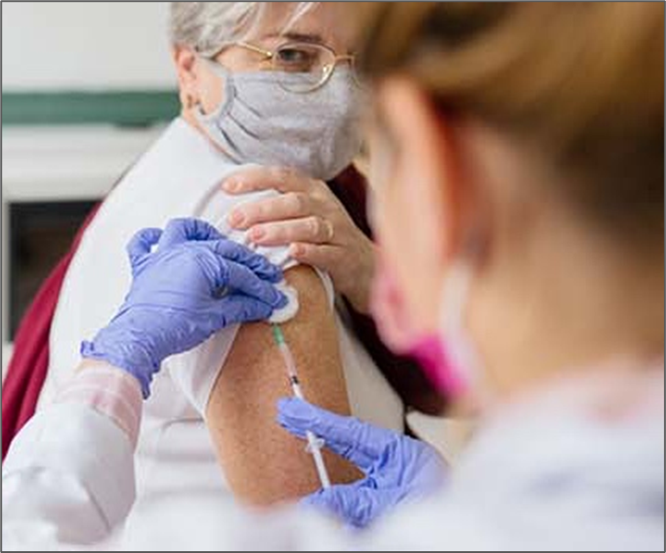
Benefits of Group Membership (Employed Physicians)
Enjoy convenient access to the tools and resources available to AOA members at a discounted group rate!
  Discounted live and on-demand CME activities
  An easy way to track CME, maintain AOA board certification and/or licensure through out physician portal
  Physician support services
  Credentialing verification through AOA Profiles
  Federal and state advocacy on behalf of Dos and osteopathic medical students
  Professional development and opportunities to grow your network
Notes:
Our Group Memberships provide all the same membership offerings that an individual membership provides. In addition to…

Slide 18

Additional Benefits of Group Membership (Organizations)
Save up to 60% off regular member pricing*
FREE Associate Memberships*​
UNLIMITED Resident/Fellow memberships​
Access to Town Hall with AOA Leadership​
Complimentary registration to OMED*​
Streamline membership dues payments with just one invoice​
Participating organizations acknowledged on our website with logo​
Speak to organization’s leaders about this new program and unlock discounted AOA benefits and services for you and your colleagues today.​
www.osteopathic.org/groupmemberships​
Notes:
Unlocking additional savings of up to 60% off of regular membership pricing. As well as:
FREE Associate Memberships*​
UNLIMITED Resident/Fellow memberships​
Access to Town Hall with AOA Leadership​
Complimentary registration to OMED*​
Streamline membership dues payments with just one invoice​
Participating organizations acknowledged on our website with logo​
Speak to organization’s leaders about this new program and unlock discounted AOA benefits and services for you and your colleagues today. For more information, you can visit: ​
www.osteopathic.org/groupmemberships​

Slide 19

GME Membership Program
Unlock discounted AOA benefits & services for GME programs
  The AOA also offers group membership options for GME training programs to help support the training of residents, fellows and interns.
    Offers access to the full extent of AOA membership at deeply discounted pricing. ​
    Provides unmatched resources in the areas of professional development, education, networking and physician services.​
    Designed exclusively to meet the needs of GME leaders, residents and fellows. ​
Notes:
Another special membership offering is the AOA’s: GME Membership Program.
The AOA also offers group membership options for GME training programs to help support the training of residents, fellows and interns.
This option offers access to the full extent of AOA membership at deeply discounted pricing. ​
Provides unmatched resources in the areas of professional development, education, networking and physician services.
And has been designed exclusively to meet the needs of GME leaders, residents and fellows. ​

Slide 20
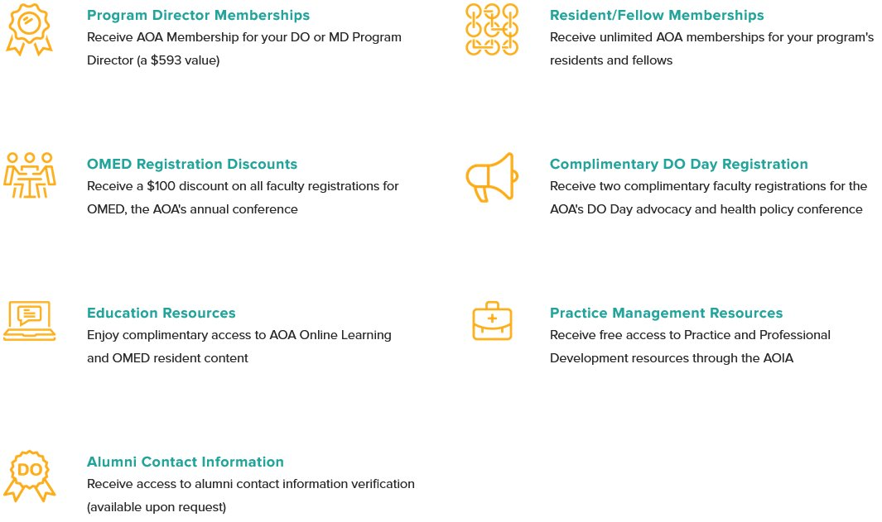
GME Membership Program Benefits
Notes:
Exclusive GME Membership Program benefits also offers:
Program Director Memberships
OMED Registration discounts
Educational Resources
Alumni Contact Information (available upon request)
Resident/Fellow Memberships
Complimentary DO Day Registrations
And Practice Management Resources

Slide 21

GME Membership Program
If you are interested or have questions about the GME Membership Program and/or Pricing, please contact: aoabilling@osteopathic.org​
If you would like to learn more about obtaining Osteopathic Recognition for your program, please contact: postdoc@osteopathic.org
Notes:
If you are interested in taking advantage of the GME Membership Program, pricing, and/or if you have any questions, please contact: aoabilling@osteopathic.org

Slide 22

Invest in Your Future with AOA Membership
We are here to advocate for you and help support you throughout your entire career.
Join the AOA today to gain access to our ever-growing list of benefits and resources.
Our thriving and diverse community is stronger when we stand and face the future together.
Together, we are #DOProud.
Notes:
I like to think of AOA Membership as an investment in your career and future with membership benefits simply being a perk, however for many the value of AOA Membership saves them time, energy, stress, and money. There is peace of mind that comes with being a Member and knowing that the AOA advocates and support us throughout our careers.
I encourage you to join today to start taking advantage of all of the resources the AOA has to provide as we are stronger together.

Slide 23

You Care for Your Patients, Let Us Care for You
Questions and don’t know where to go?
Our Member Resource Center is here to help answer your questions and assist with:
  CME
  Board certification
  Member benefits
  Student and Resident affairs
  Event registration
  And more!
For assistance, please contact the MRC:
  Phone: (312) 202-8000, select Option 1
  Email: MemberService@osteopathic.org
Notes:
With so many offerings, it’s natural to have questions. The AOA’s Member Resource Center is a dedicated one-stop shop for all of your needs. Whether you have questions on getting started, taking advantage of your AOA Membership, how to find and access any of your benefits, or you have questions but you don’t know where to go; AOA staff will have answers or connect you with the appropriate departments to ensure that you’re taken care of.
If you’re interested in joining the AOA, you can do so at any time online at osteopathic.org. Simply log in and click “Join the AOA” at the very top of your screen. If you have log in issues, or if you’d prefer to join over the phone, simply call the Member Resource Center, and a staff member will be able to assist you from there.
Feel free to take a picture of this slide, or write down the contact information provided. The Member Resource Center is available by phone Monday through Friday, 8:30am to 4:30pm CST, or by email at: memberservice@osteopathic.org.

Slide 24
Thank you
Speaker Name & Credentials
Notes:
Thank you so much for your time today. If you would like to get more information on the AOA and Membership or have a staff member of the AOA reach out to you directly, I will have a sign-up sheet up here.
Thank you again, and I hope you consider joining me as a proud member of the AOA!

